Slide 1
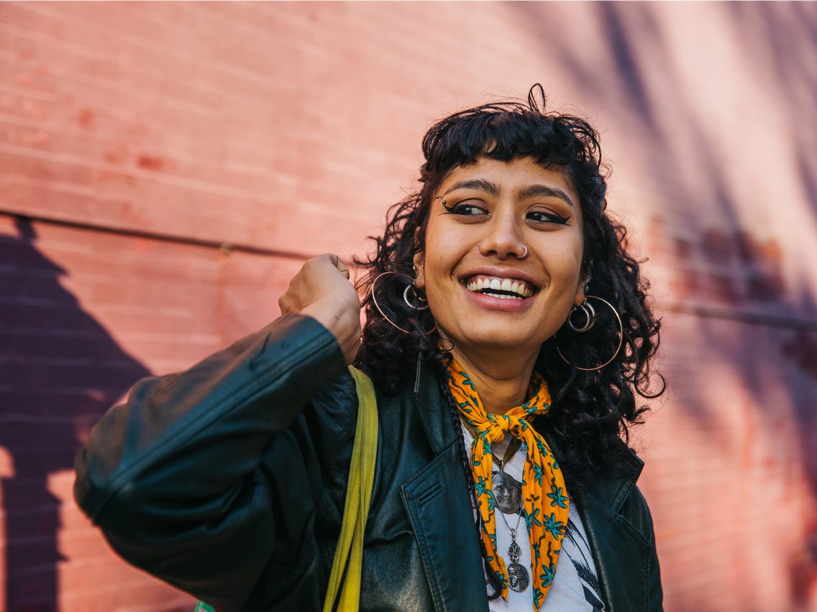
“Riding my bike helps me relax and improves my health”
Add image that represents this persona
Goals
Finish school to become a Physician Assistant
Start riding her bike with her sisters and spend time with them
Frustrations
Angela has a busy schedule and it makes it hard for her to find time to ride her bike
Needs special pedals for her feet
Hard to navigate websites that are cluttered
Angela
Age:
Education:
Hometown:
Family:
Occupation:
22
Associates in Arts
San Diego, California
2 Sisters
Office Assistant
Angela is a thriving millennial located in San Diego. She is the middle child in her family as she has a older and younger sister. Angela and her sisters used to ride their bikes all the time as kids, but they haven’t in a long time and want to start again. Since Angela is back in school and working full time, her schedule is a bit limited. However she wants an easy and convenient way to find and buy custom bikes for her and her sisters.

Slide 2
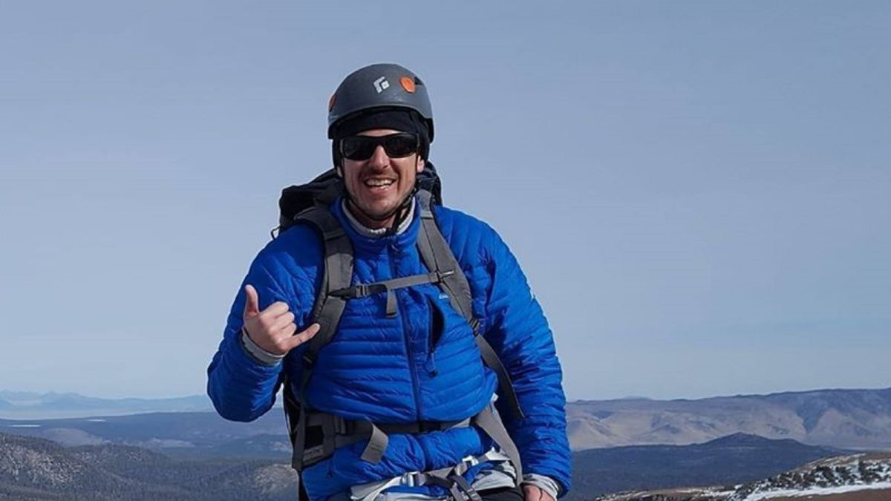
“I am an adventurous person who likes to use my bike whenever I can.”
Add image that represents this persona
Goals
Obtain a promotion at his company
Perform a Triathlon
Frustrations
The user can’t find customized bikes
Has a ankle injury
Isn’t too tech savvy
Doesn’t have availabilityy to go to a local shop for a bike
Cliff
Age:
Education:
Hometown:
Family:
Occupation:
33
Bachelors in Forensics
Charlotte, NC
Single
Investigator
Cliff is a bachelor who lives in the heart of downtown Charlotte, NC. Cliff works as a investigator for a Forensics company. He uses his bike whenever he can. Whether that’s commuting to work, on a trail, for a workout, or just a relaxing ride for fun with his friends. However he has some frustrations with ordering bikes online. He wants a bike he can customize for his needs, and is affordable.

